Slide 1
Day Care
Group One
CSYE 6200
Chengyan Mu, Feifan Tai, Jing Dai, Siwei Zhou
Ziwen Wang, Zuyue Xie

Slide 2
Overview
OOP
Simple Factory
POI API
Java Swing GUI

Slide 3
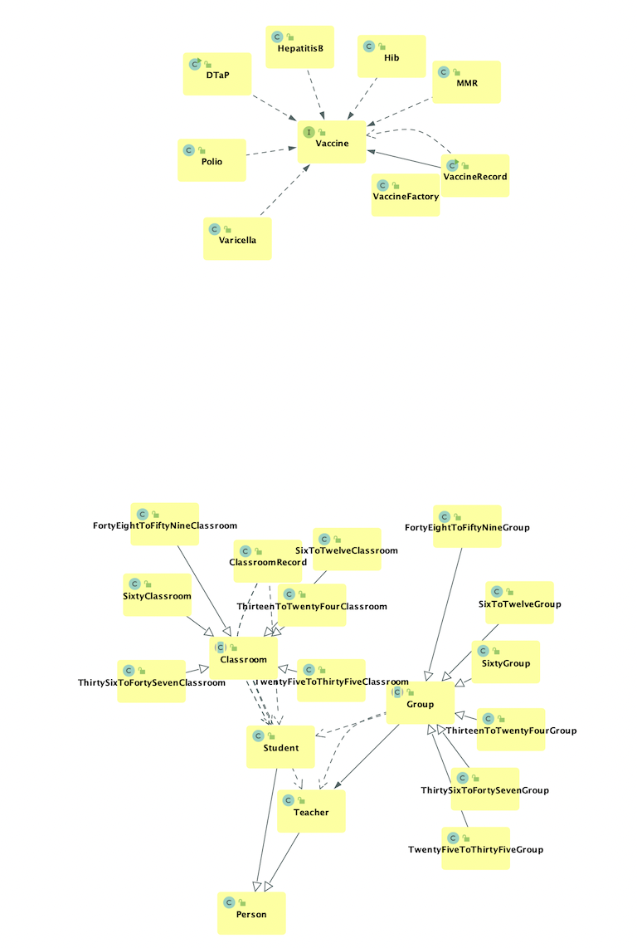
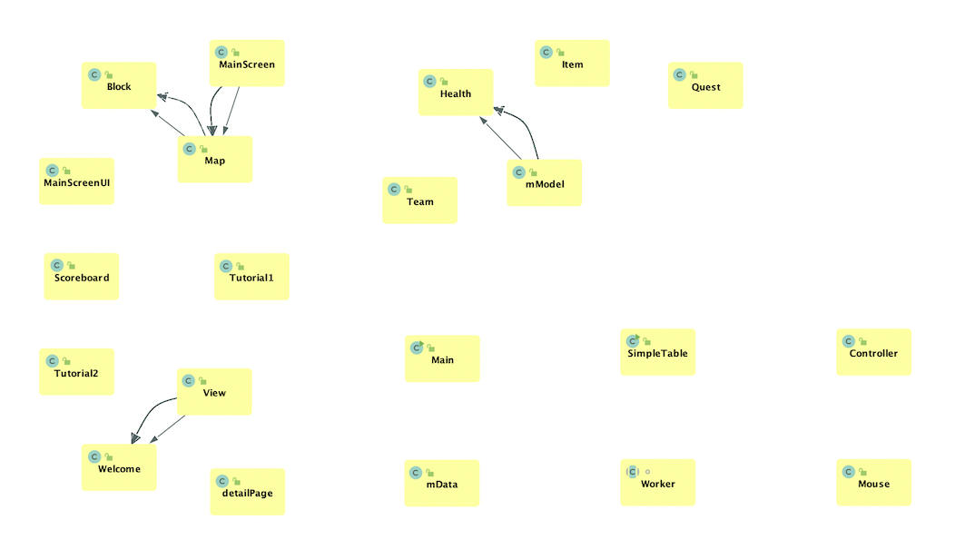
UML Diagram

Slide 4
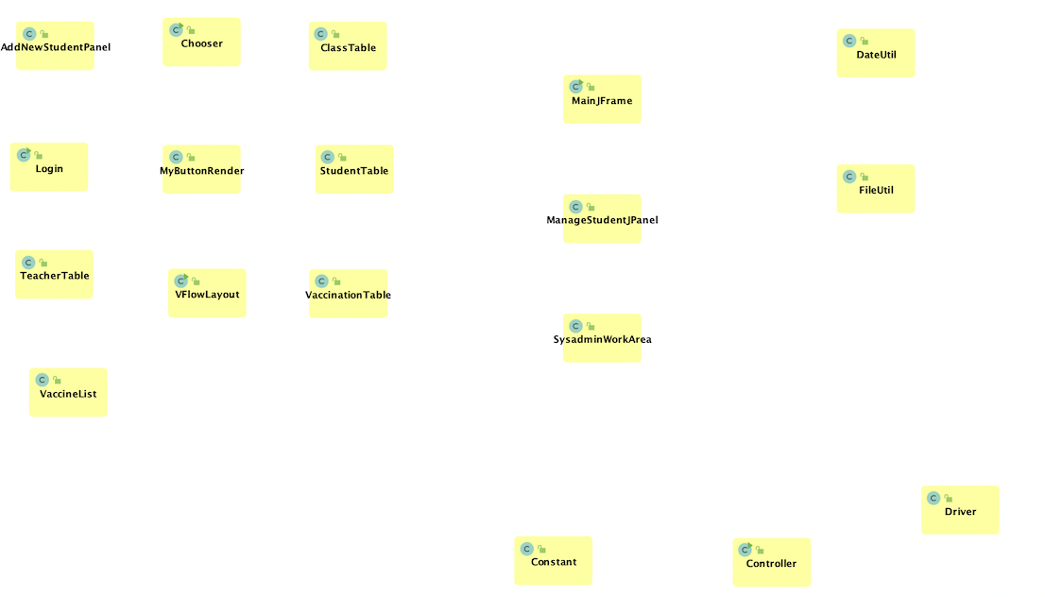
UML Diagram cont.

Slide 5
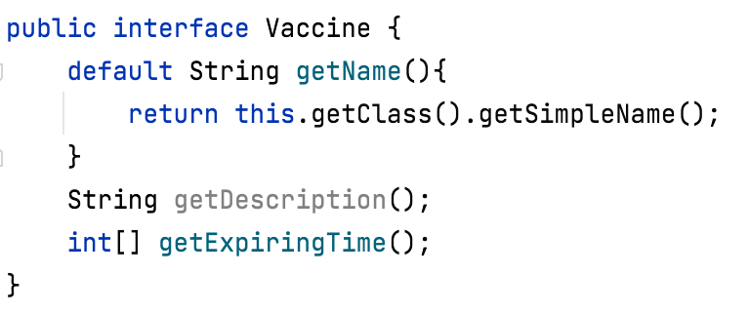
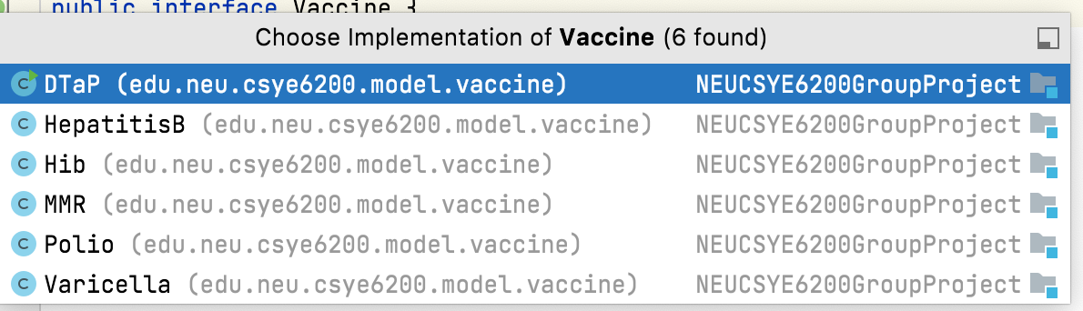
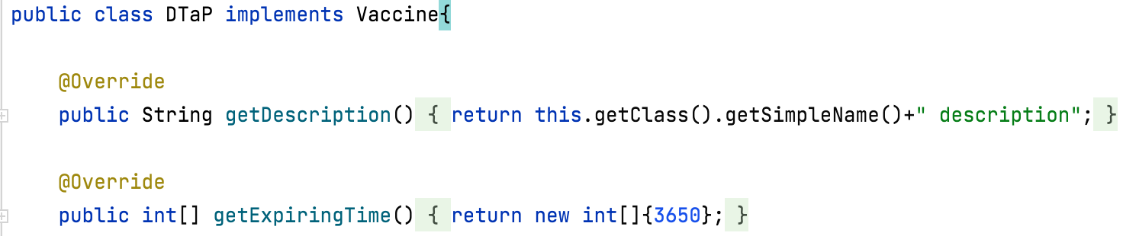
Polymorphism - Vaccine

Slide 6
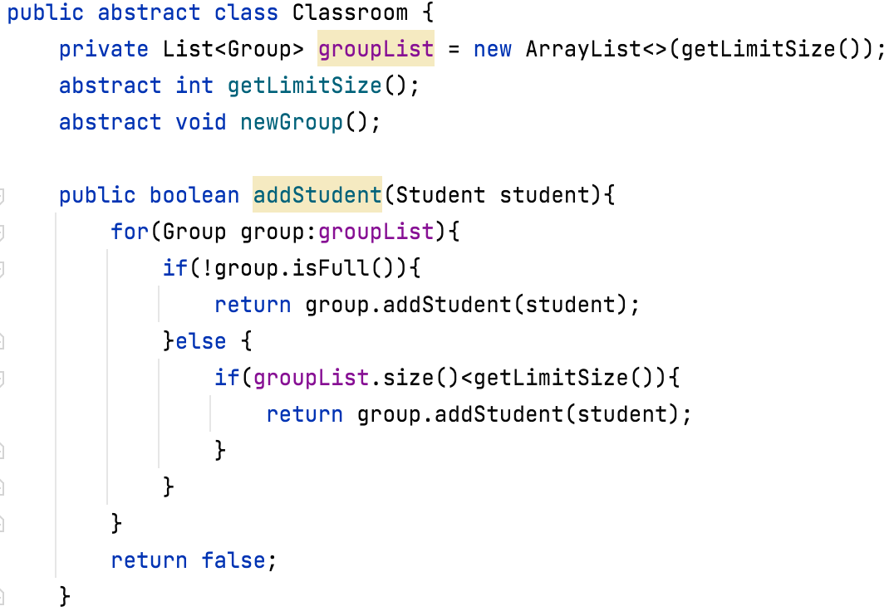
Polymorphism - Classroom

Slide 7
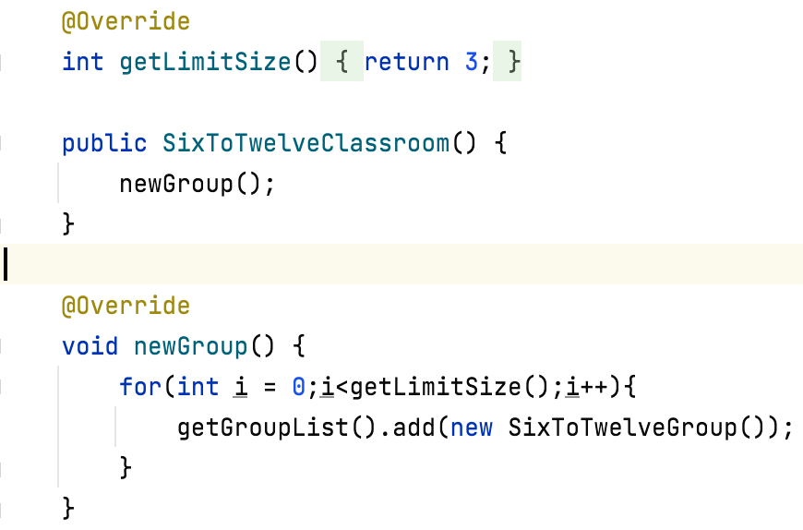
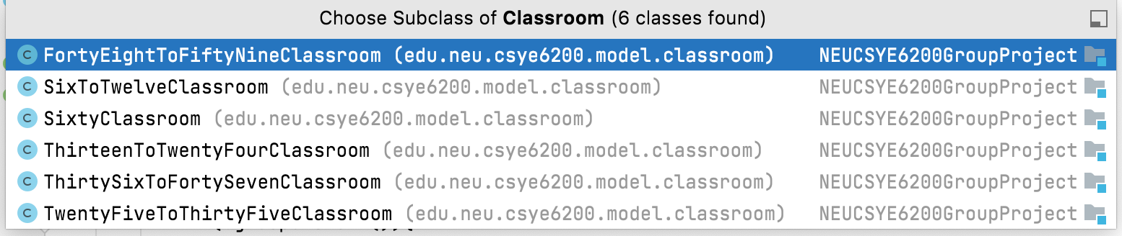
Polymorphism - Classroom

Slide 8
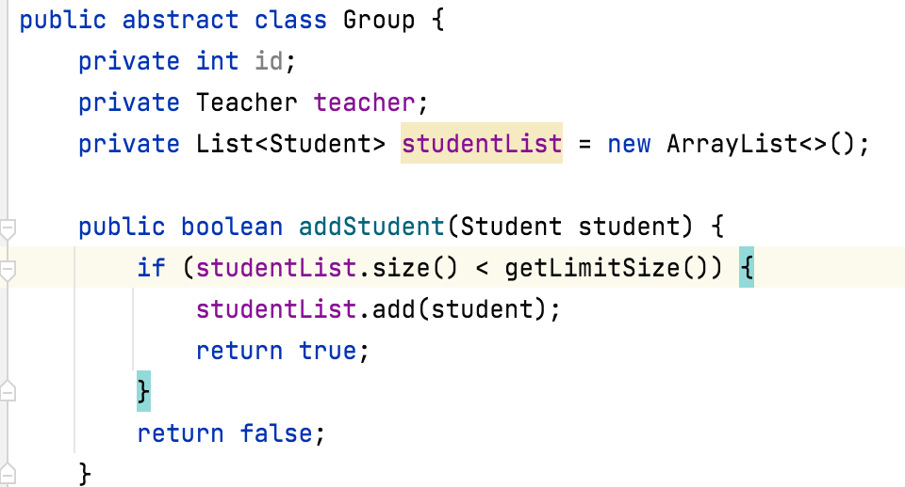
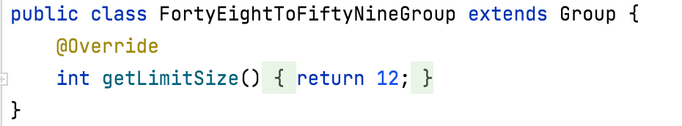
Polymorphism - Group

Slide 9
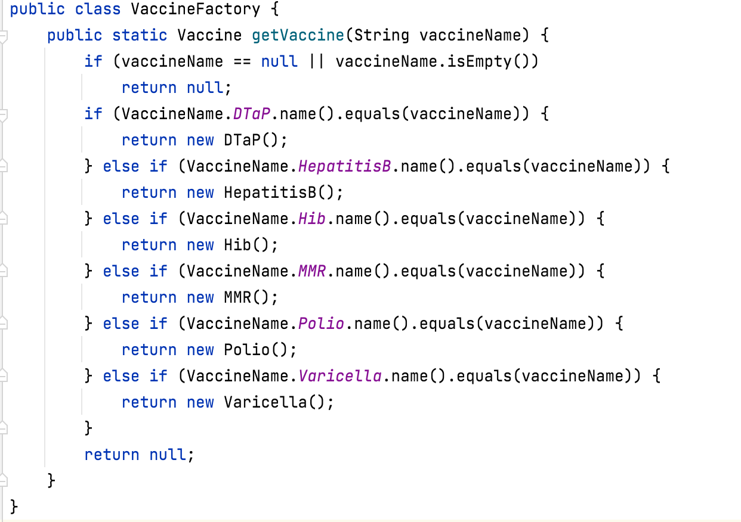
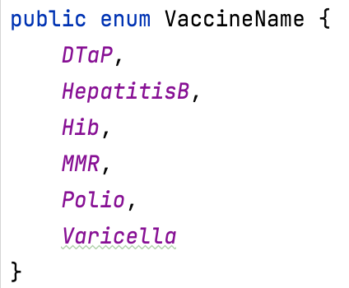
Simple Factory

Slide 10
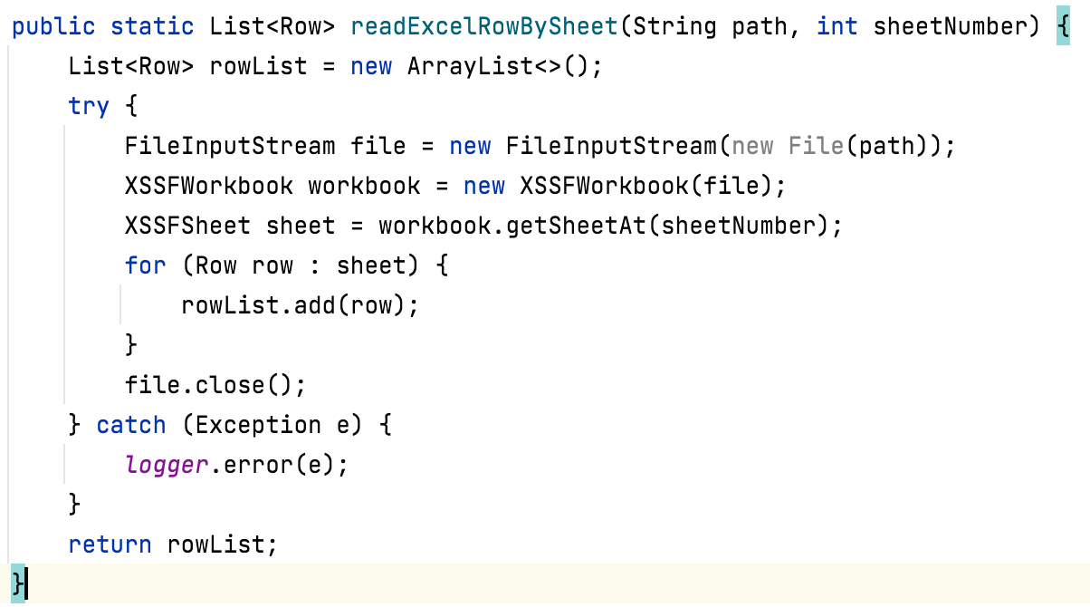
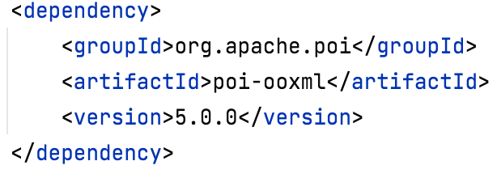
POI

Slide 11
Contributions
GUI Design : Chengyan Mu, Feifan Tai
Front-end : Jing Dai, Siwei Zhou
Back-end : Ziwen Wang, Zuyue Xie
Stability Test : Zuyue Xie

Slide 12
Future enhancement
01
Day care server
02
Reliable data storage

Slide 13
Demo

